Slide 1
JAGGAER NON-CATALOG “MANUAL INVOICE” TRAINING GUIDE
August 2025

Slide 2
Non-Catalog Manual Invoice Process
NOTE: BE SURE TO WRITE THE ORIGINAL PURCHASE ORDER NUMBER ON THE INVOICE IF NOT ALREADY IDENTIFIED.
Locate PO in Jaggaer
Go to the ‘Attachments’ tab located at top-middle of the page and attach a copy of the Invoice
Go to the 'Invoices' tab at the top. Click the “+” sign.
Go back to the 'Entry' tab and fill in the Supplier Invoice Number and the Invoice Date.
Confirm the Remit to address matches the invoice, if not, select the pencil icon to select correct remit address.
Scroll down and make sure the line items in Jaggaer match the final line items on the invoice, and edit if necessary.
Select 'Complete' at the top right of the page to submit the invoice.
NOTE: REFER TO THE SEPARATE MANUAL INVOICE STEP BY STEP GUIDE FOR MORE DETAILED INSTRUCTIONS AND SCREENS.

Slide 3
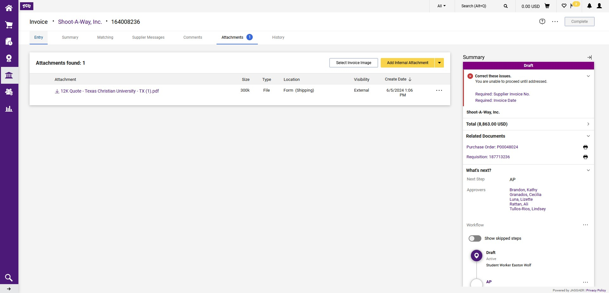
Locate your original purchase order in Jaggaer.
Go to the ‘Attachments’ tab located at top-middle of the page and attach a copy of the Invoice

Slide 4
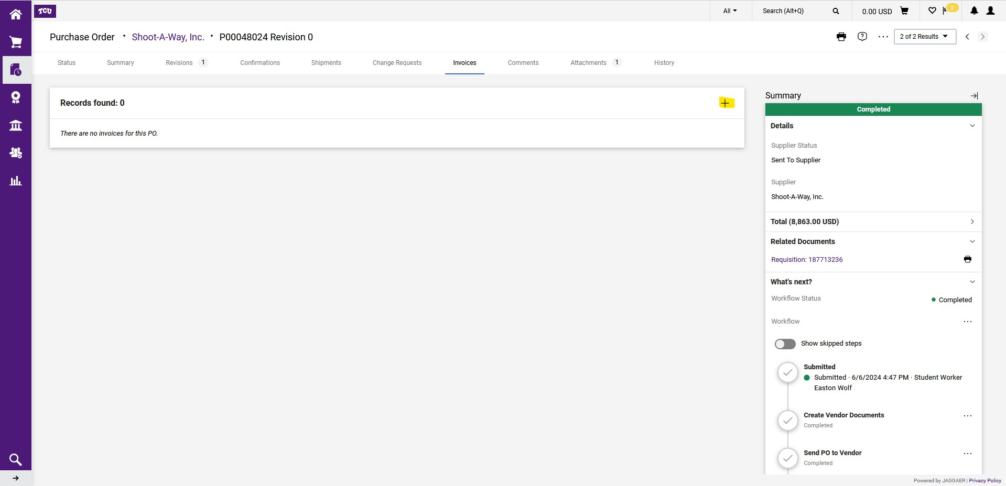
On the 'Invoices' tab at the top then Click the “+” sign.

Slide 5
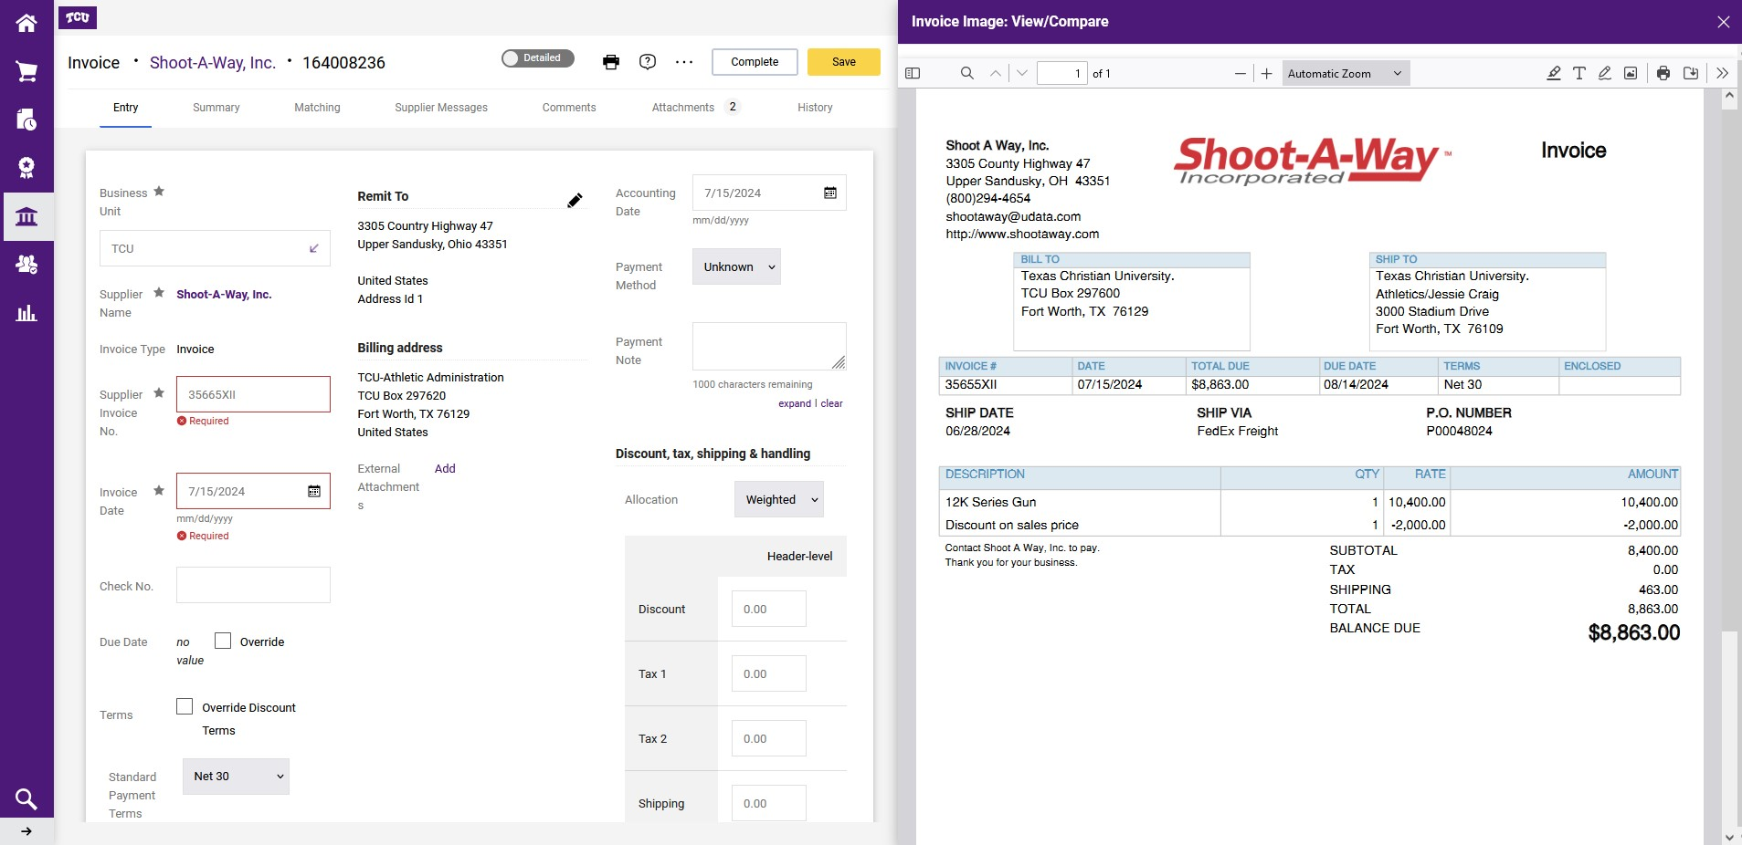
Go back to the 'Entry' tab and fill in the Supplier Invoice Number and the Invoice Date.
Make sure that the ‘Remit to’ address matches the invoice, if not select the ‘pencil’ icon to select the correct address.
Scroll down and make sure the line items in Jaggaer match the final line items on the invoice, and edit if necessary.

Slide 6
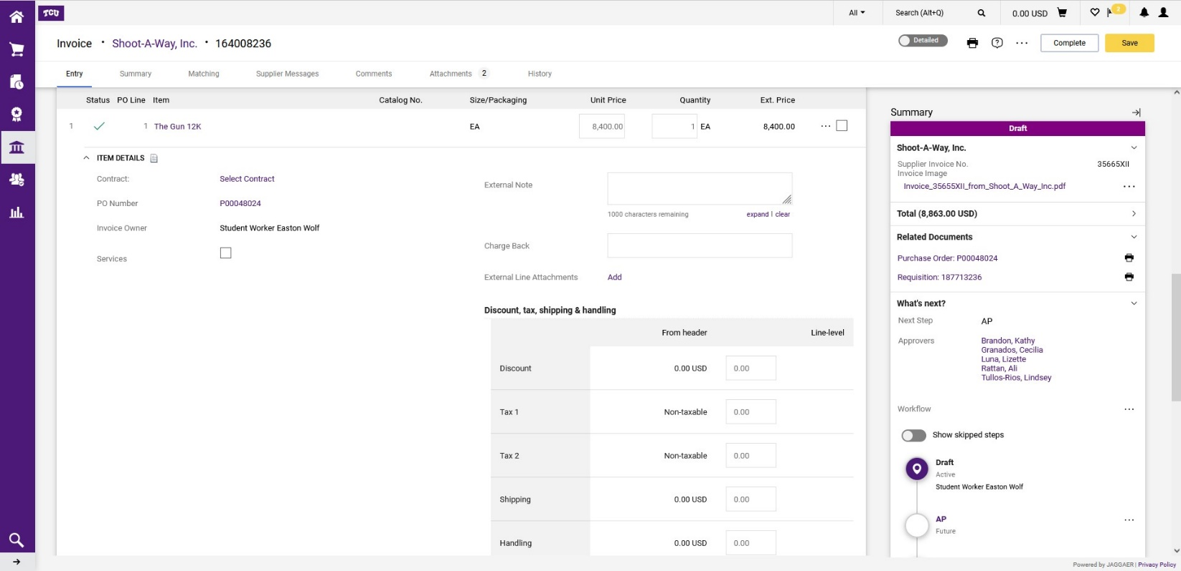
If all lines and total match the invoice then select 'Complete' at the top right of the page to submit the invoice.

Slide 7
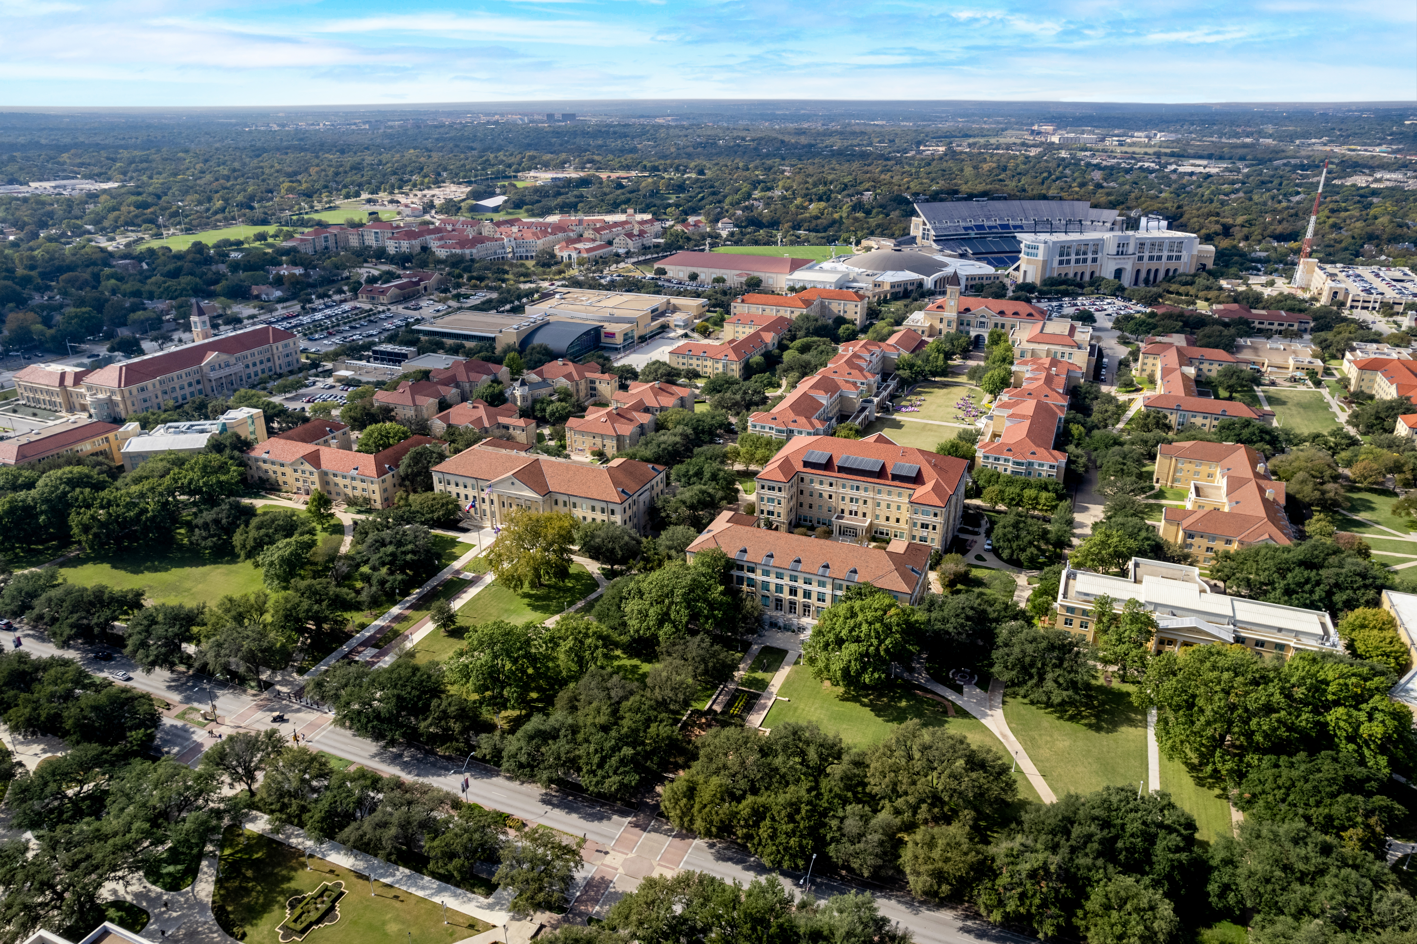
QUESTIONS?
Submit to procurement@tcu.edu

